Slide 1

Software Engineering
CSCI 275

Slide 2
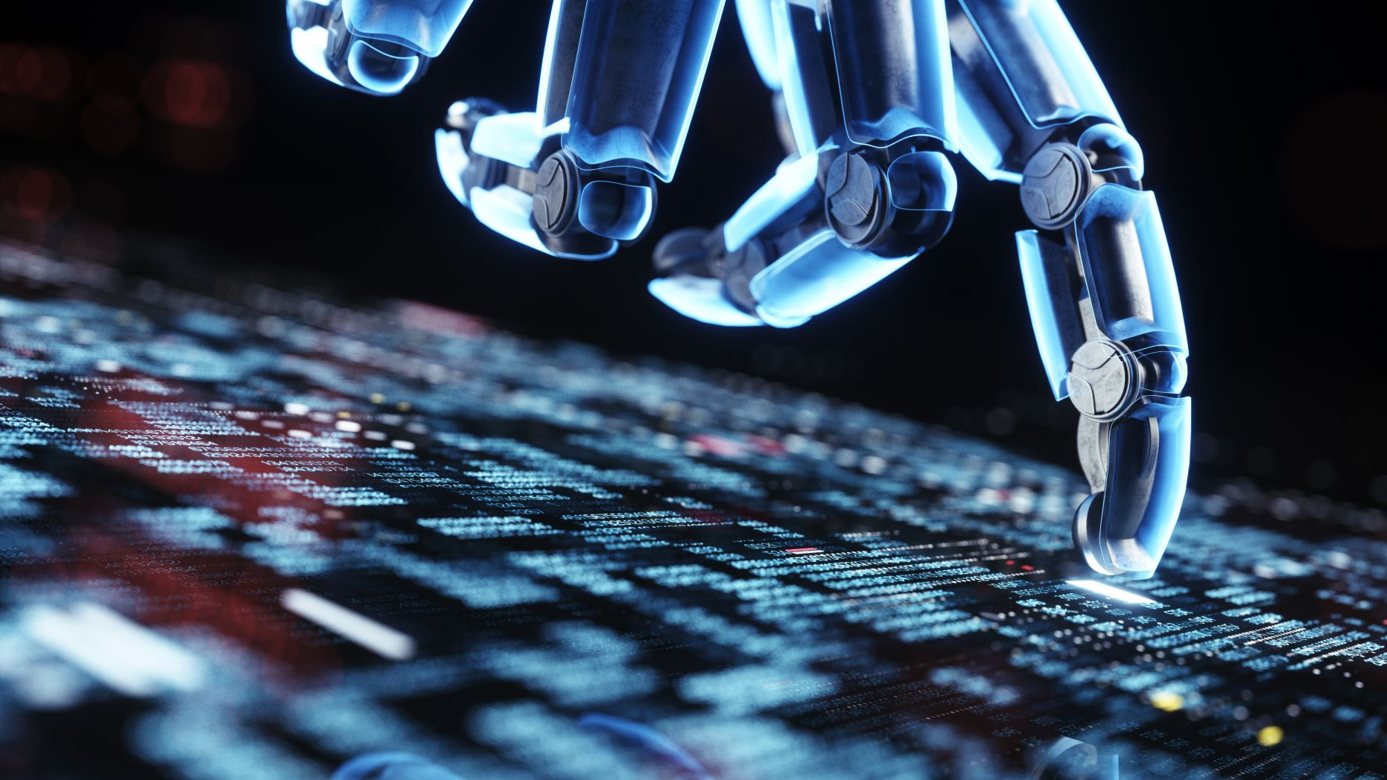
Virtual Assistants
Unleashing the power of Artificial Intelligence
Gurkamal Singh Jandu Mateo Ysla

Slide 3
Virtual Assistants
Programmed to assist users
Commonly found in smart devices, phones, computers and homes
Capable of performing a diverse range of functions
Playing Music, Scheduling appointments, and setting reminders.

Slide 4
Development of Virtual Assistant
Two tools are used: 1. TensorFlow 2. Natural Language Toolkit(NLTK)
Collection of Large Dataset of text and audio inputs
Use TensorFlow to train the deep learning models

Slide 5
Development of Virtual Assistant
Two tools are used: 1. TensorFlow
2. Natural Language Toolkit(NLTK)
Collection of Large Dataset of text and audio inputs
Use TensorFlow to train the deep learning models

Slide 6
Development of Virtual Assistant
Two tools are used: 1. TensorFlow 2. Natural Language Toolkit(NLTK)
Collection of Large Dataset of text and audio inputs
Use TensorFlow to train the deep learning models

Slide 7
Development of Virtual Assistant
Two tools are used: 1. TensorFlow 2. Natural Language Toolkit(NLTK)
Collection of Large Dataset of text and audio inputs
Use TensorFlow to train the deep learning models

Slide 8

Development of Virtual Assistant
TensorFlow
Open-Source
Ease of Use
Layers featuring

Slide 9
Development of Virtual Assistant
Natural Language Toolkit
Language Data
Text Processing
Preprocess and analyze the dataset

Slide 10
Development of Virtual Assistant
Dataset
Text, Audio, Image
Diverse range
Human understandable

Slide 11

The next step: Using the trained model
Processing the input and generation of output
This involves:
Speech Recognition
Intent recognition

Slide 12
Speech recognition
Involves converting audio inputs to text
Model Determines the intent of the user
Generation of appropriate response
Natural Language Generation

Slide 13
Intent Recognition
Cleaning up of sentence
Bags of words
Predict Class
Get Response

Slide 14
Intent Recognition
Cleaning up of sentence
Bags of words
Predict Class
Get Response

Slide 15
Intent Recognition
Cleaning up of sentence
Bags of words
Predict Class
Get Response

Slide 16
Intent Recognition
Cleaning up of sentence
Bags of words
Predict Class
Get Response

Slide 17
Intent Recognition
Cleaning up of sentence
Bags of words
Predict Class
Get Response

Slide 18


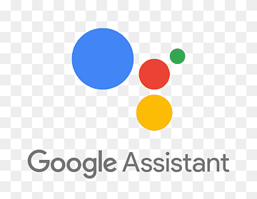

Summary of the development
Train a model in a separate file.
Process user input and generate output.
In a separate file, check the input and select the appropriate output.
Take place on different modules within the code.

Slide 19
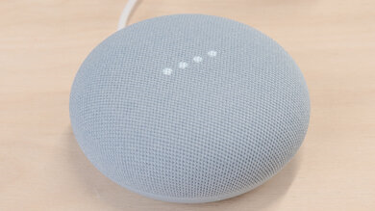
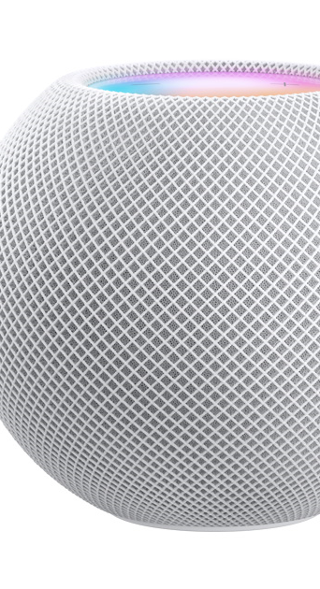



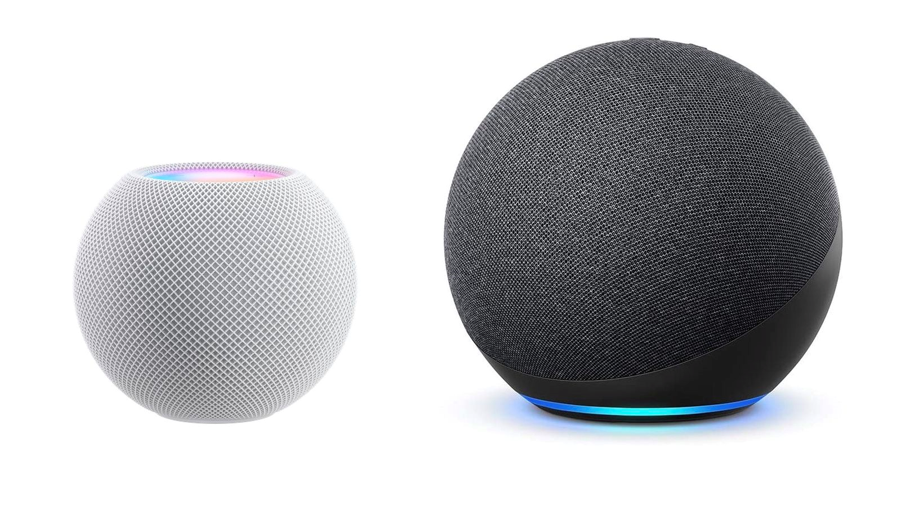

Live demonstration of Virtual assistant

Slide 20
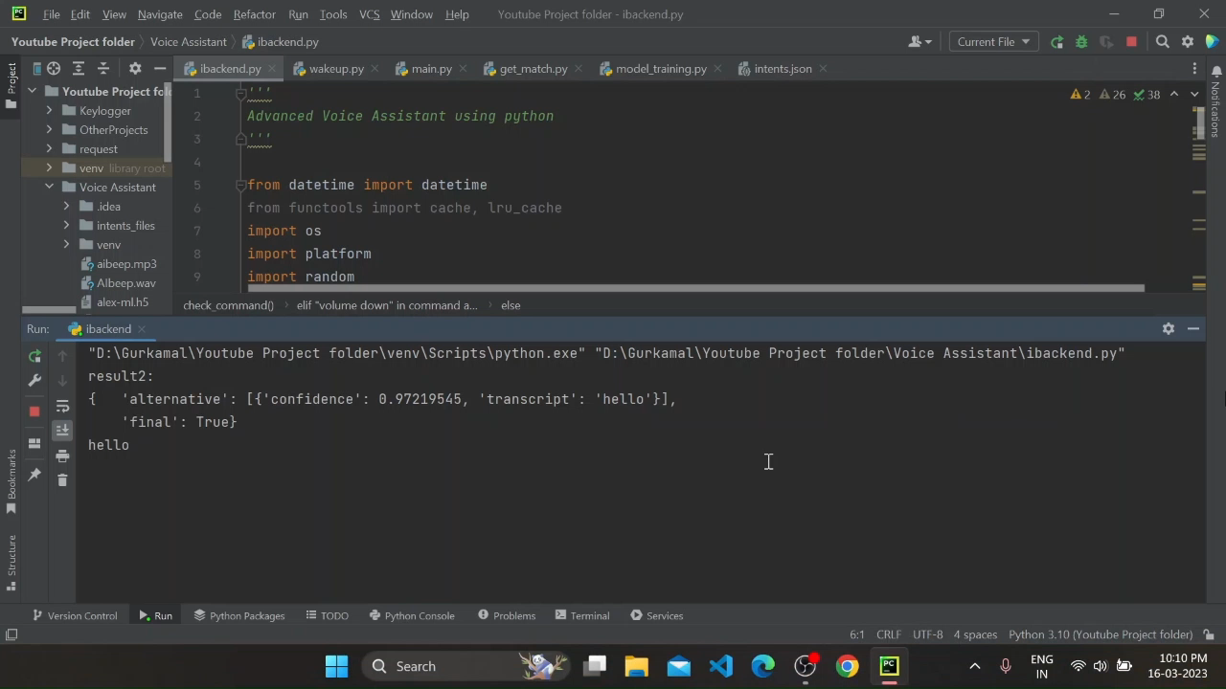

Slide 21


Slide 22
THANK YOU

